Slide 1
ANALYSIS OF FLIGHT DISRUPTION DATA TO DETERMINE PROBLEM AREAS UTILIZING DATABASE APPLICATIONS
PRESENTED BY:
Jordan Sanders, Tyler Martin,
Sean Jennings, Fadjimata Issoufou
ERAU
CS_540 Khem N. Poudel, PhD

Slide 2
CONTENTS
Abstract …………………………………………………………… Slide 3
Introduction ………………………………...……………….… Slide 4
Methodology ……………………..…………………………… Slide 6
Overview ………………………………………………………… Slide 9
Interface Features ………………………………………… Slide 10
Diagrams …………………………………………………………….. Slide 11
Database Design ……………………………………………… Slide 12
Website Mockup Design ………………………….…….. Slide 21
Future Work ……………………………………………………. Slide 44
References …………………………………………………….... Slide 57

Slide 3
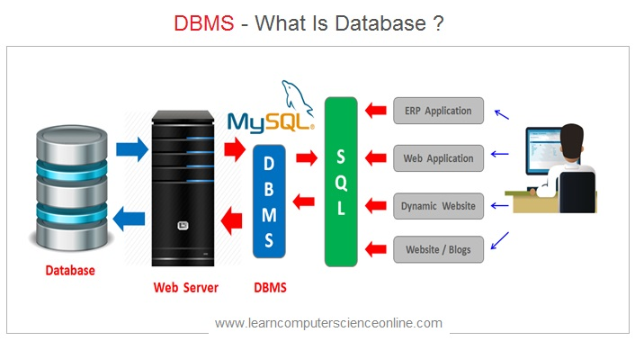

ABSTRACT
USE A RDBMS TO CREATE A WEBSITE INTERFACE
WEBSITE INTERFACE RELAYS FLIGHT DELAY/CANCELLATION INFORMATION

Slide 4

DATA RETRIEVAL
INTRODUCTION
The main goal of the project is to create a database management system (DBMS) with a web interface that shows delay and cancellation patterns. Ideally, the system will show patterns based on either:
Geographical location
Specific Airport
Airline
Data will be collected from the Department of Transportation’s Bureau of Transportation Statistics.

Slide 5
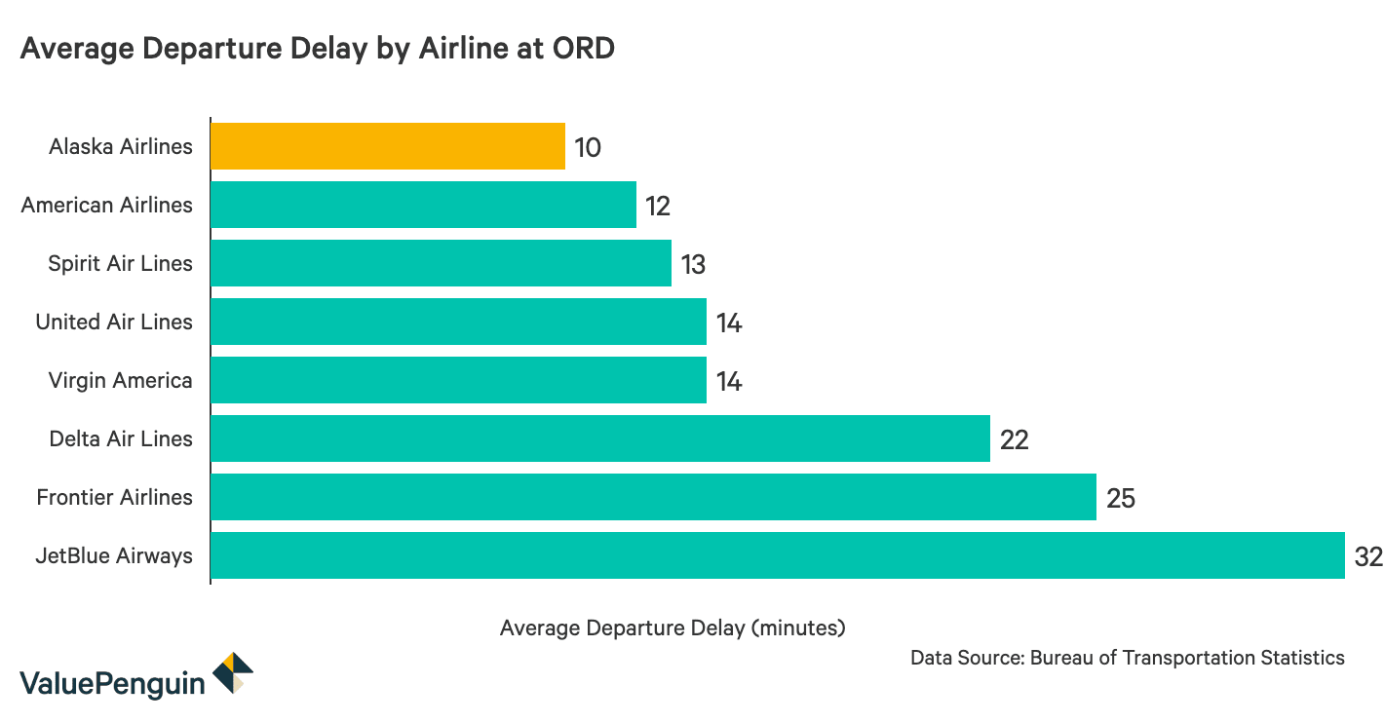
INTRODUCTION
DELAYS
In 2007, the U.S government had endured 31–40 billion dollar downsides due to flight delays… in 2017, 76% of the flights arrived on time”[4]. The desire to keep planes flying as much as possible does not schedule enough time for delays and any problem with the plane or flight logistics will cause a delay. Predicting these delays can save airlines and passengers significant time, money, and frustration.

Slide 6
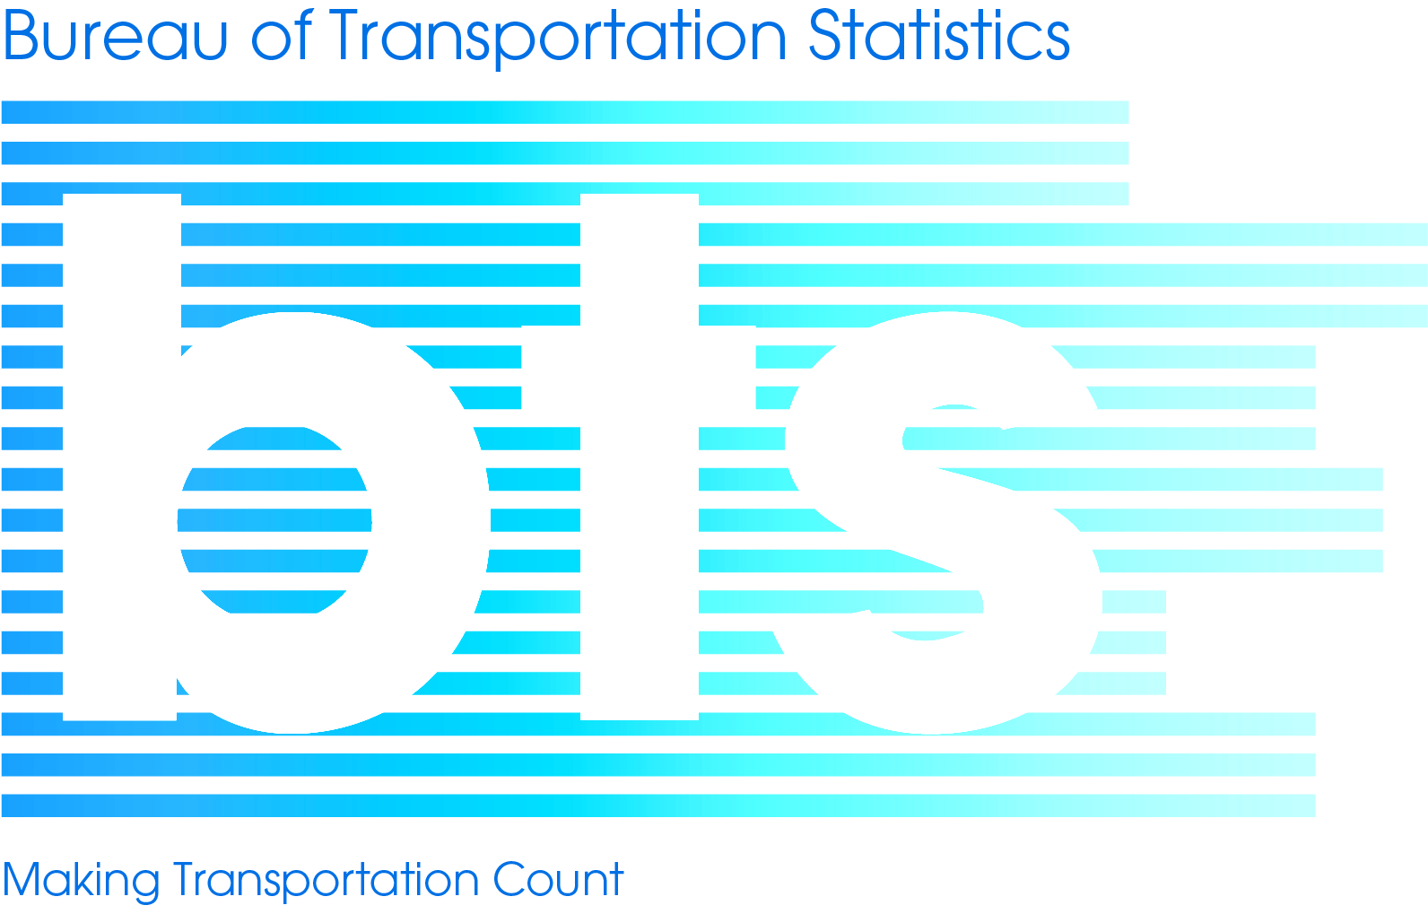
Methodology
DATA RETRIEVAL SOURCES
The Bureau of Transportation Statistics (BTS), part of the Department of Transportation (DOT) is the preeminent source of statistics on commercial aviation, multimodal freight activity, and transportation economics, and provides context to decision makers and the public for understanding statistics on transportation.[1]

Slide 7
DATA DESCRIPTION
The data set is called “Marketing Carrier On-Time Performance.” [2] It contains many useful attributes including:
Time period
Day of week, day of month, flight date, etc.
Airline
Origin / Destination
Airport, City, State, etc.
Departure / Arrival performance
Time, delay, etc.
Cancellations / Diversions
Cause of Delay
Carrier, weather, security, etc.

Slide 8
LITERATURE REVIEW
“In 2016, research for a post-flight data analysis using databases implied that in conventional systems, aircraft data was typically recorded in the form of files on a storage medium and handled by each flight sortie separately. As a result, as the number of flight sorties grows, so does the time spent searching for data for analysis. Instead of file-based flight data maintained by flight sortie, they proposed database-based data integration and management. This solution allows people to simply store and manage all of the real-time data in a database so that people may use it for visualization and in a variety of application programs.”
Flight Data Visualization and Post-test Flight Data Analysis
System by Using Database by Jong-Ik, S. and Gyu-Se J.

Slide 9

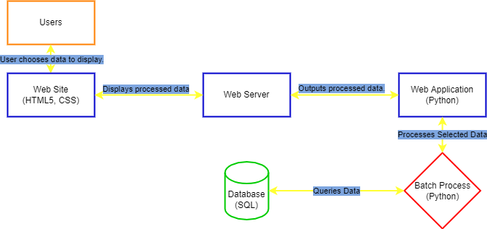

DATABASE MANAGEMENT SYSTEM
The research result will be presented in form of problem areas and likelihood or prediction of future flights delays due to unforeseen circumstances.
Relational Database
The most common use for mySQL is for the purpose of a web database.
WHM VPS Web-Hosting
HTML5 (Hypertext Markup Language) is the code used to structure a web page and its content. CSS(Cascading Style Sheet) is for style.
Our system design will translate into

Slide 10
INTERFACE FEATURES
WEB INTERFACE
USER WILL SELECT:
Geographical location
Listed by state/territory
(may also be listed by city for larger cities)
Airport
Airline
Maybe cause of delay
WEBSITE WILL PULL INFORMATION FROM DATABASE SYSTEM:
Data in the DBMS is organized in the same manner the user will select information
WEBSITE WILL DISPLAY:
Charts and graphs about
The causes of delay
The average frequency of delay
DATA ANALYSIS:
Once the proper data is pulled from the database, charts will be made

Slide 11
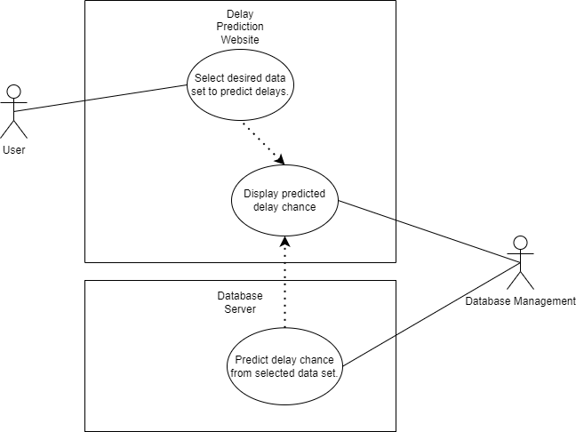
USE CASE DIAGRAM
WEBSITE USE CASE

Slide 12
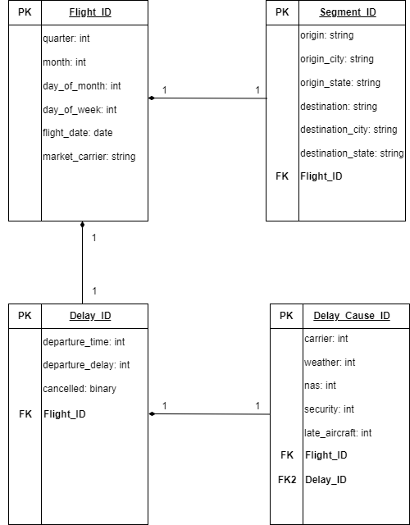
MySQL
Tables
Relationships

Slide 13
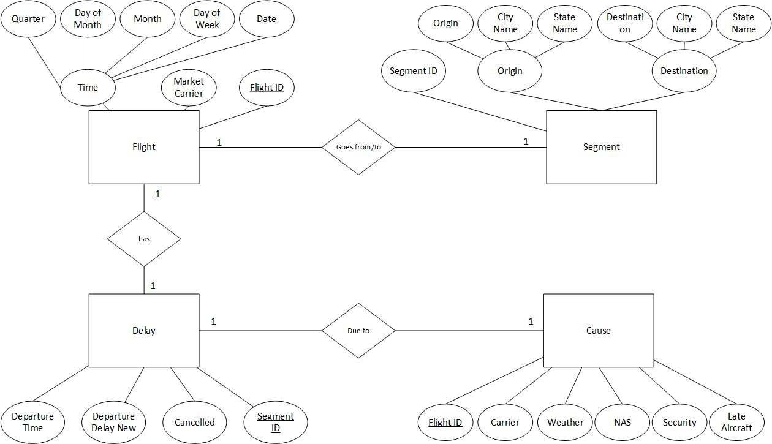
(ER) DIAGRAM
Entity
Relationship
Diagram

Slide 14
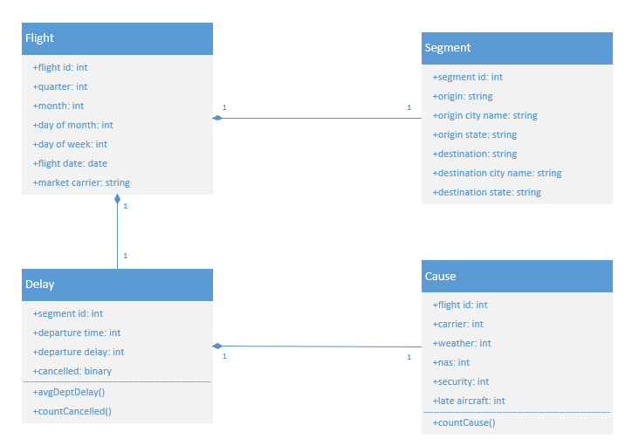
UML CLASS DIAGRAM

Slide 15
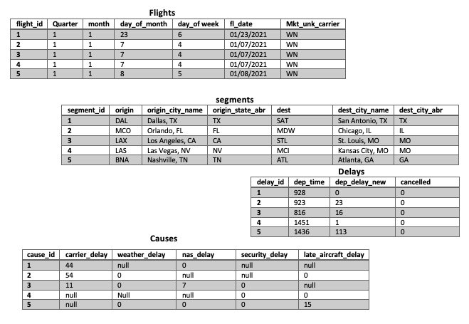
MySQL Tables data view + Relationships

Slide 16
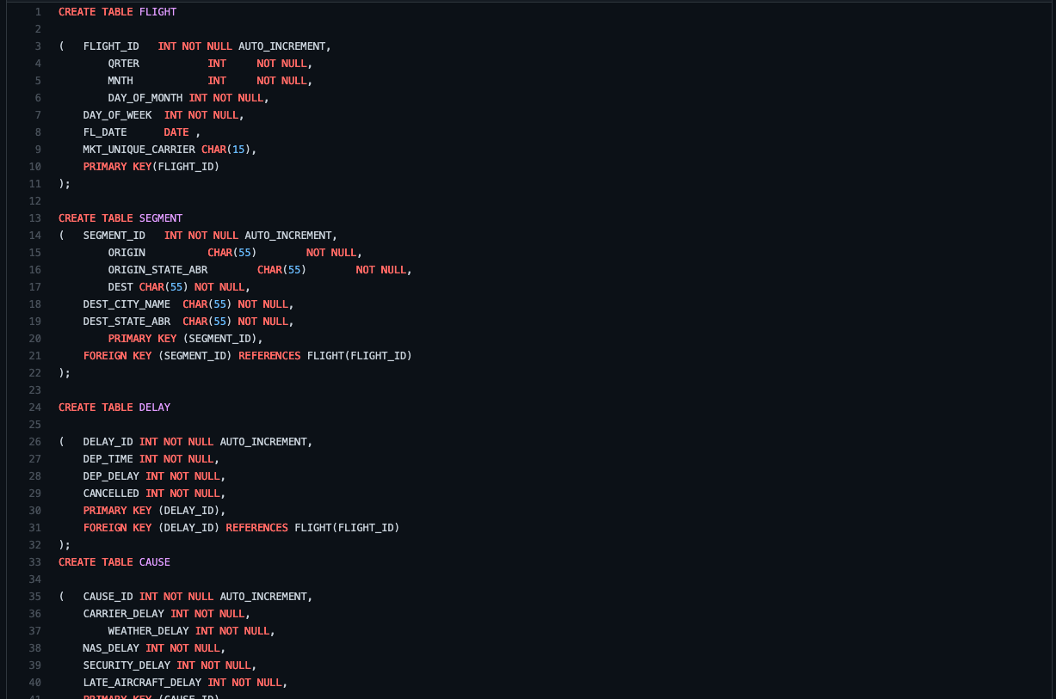
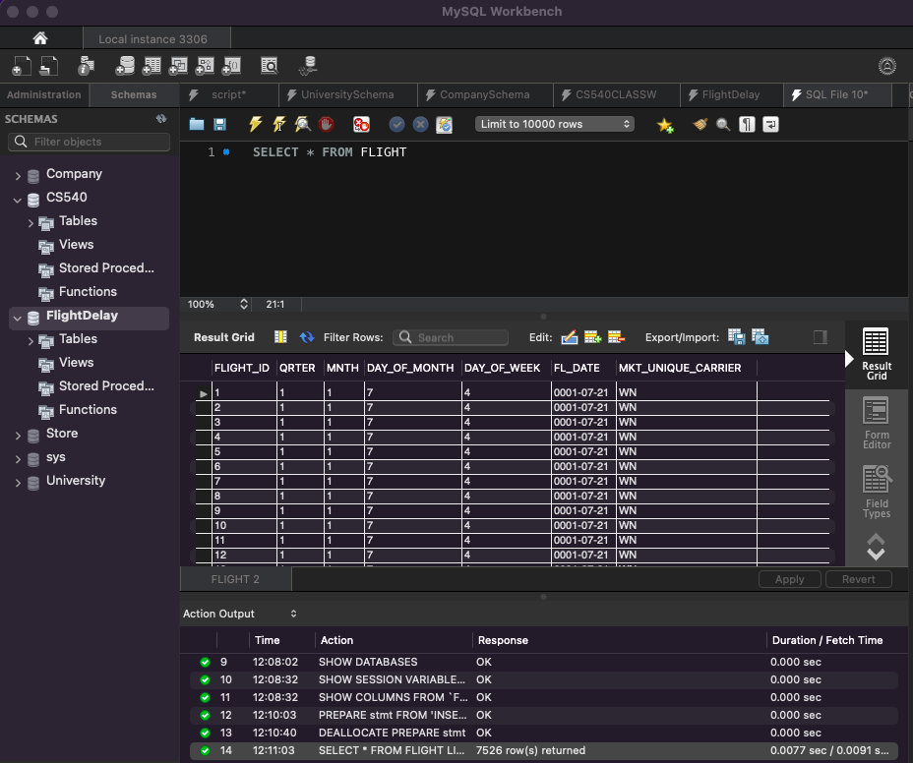
FLIGHT TABLES DATA Screenshots

Slide 17
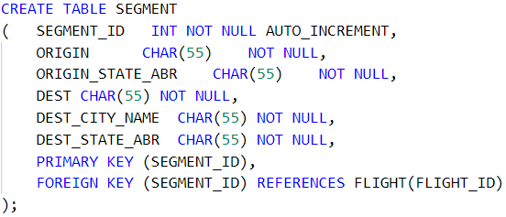
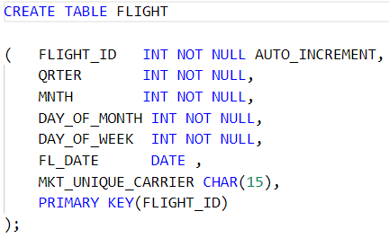
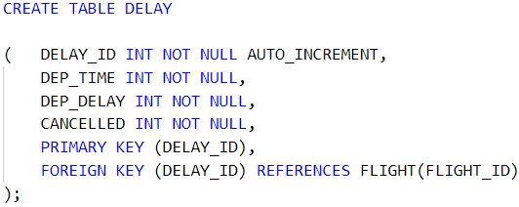
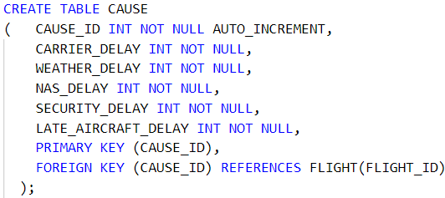
MySQL DATABASE TABLES SCHEMA
Black
White

Slide 18

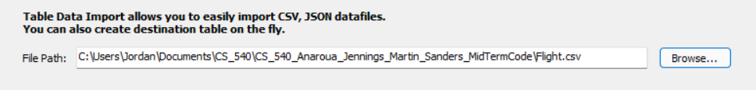
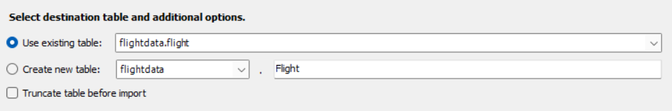
LOADING DATABASE INTO SQL FILE

Slide 19
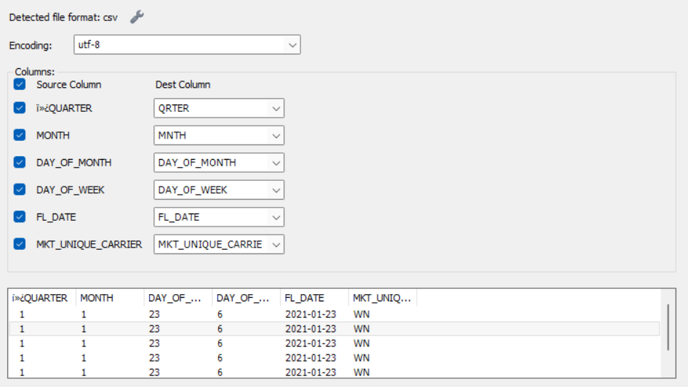
LOADING DATABASE INTO SQL FILE
REPEAT FOR EACH TABLE

Slide 20
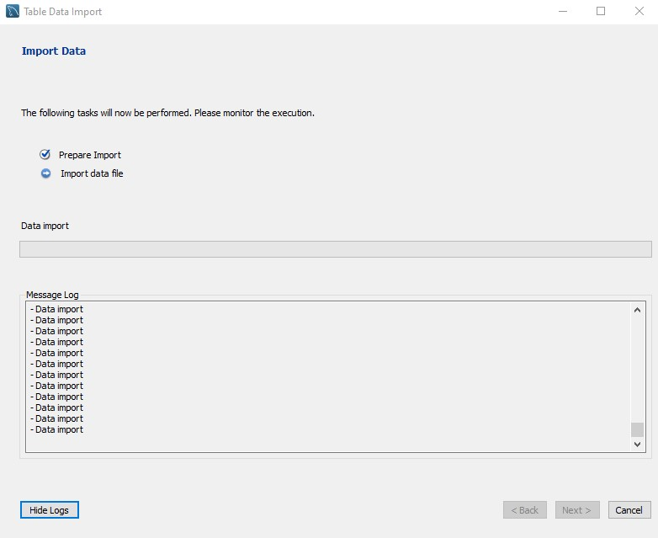
LOADING DATABASE INTO SQL FILE

Slide 21
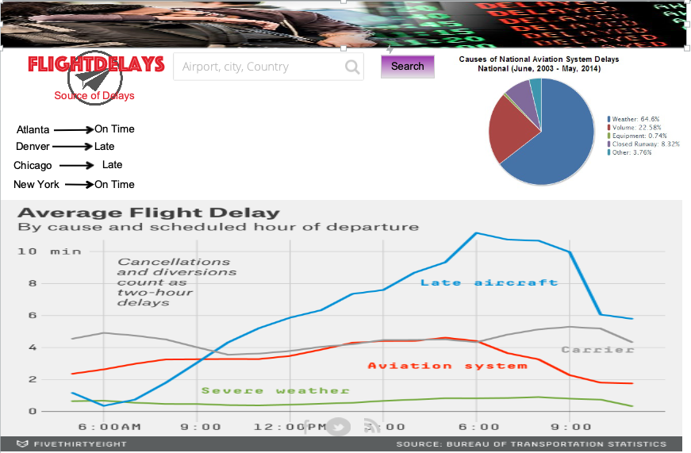
MOCKUP DESIGN
INITIAL WEBSITE DESIGN

Slide 22
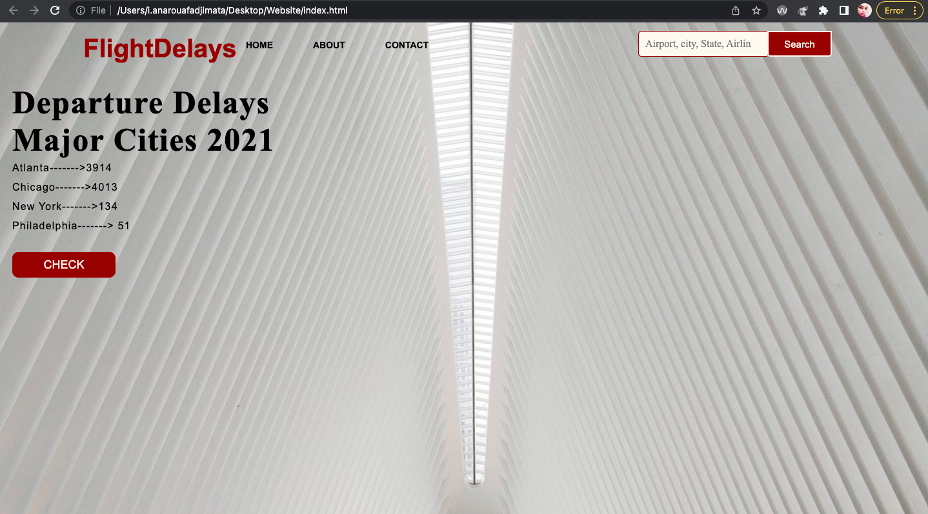
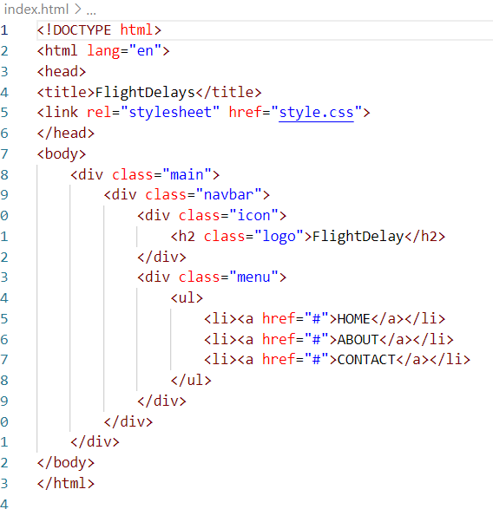
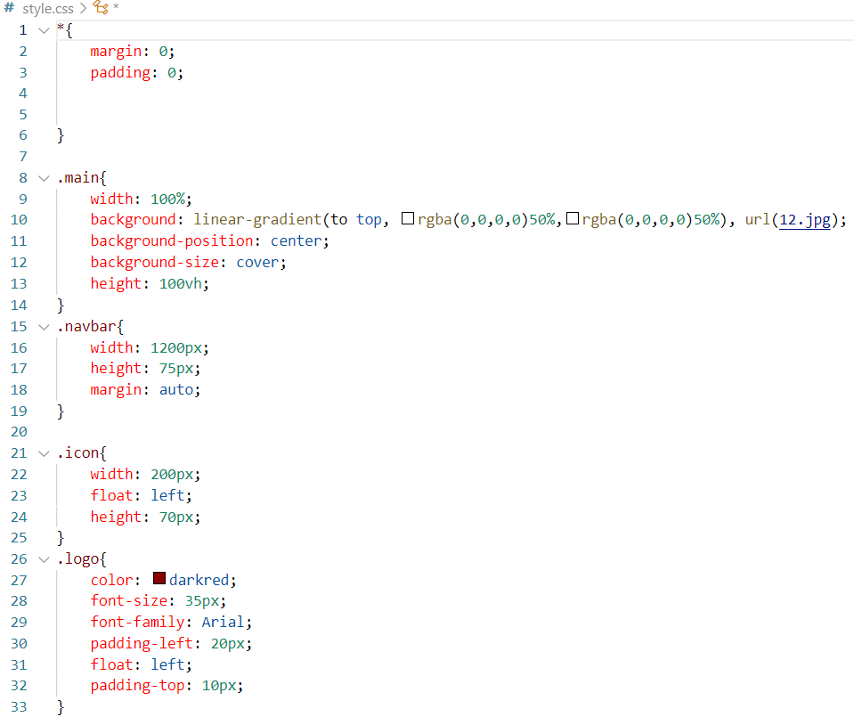
WEB INTERFACE PREVIEW
WEBSITE DEVELOPMENT
.
HTML CODE CSS CODE

Slide 23
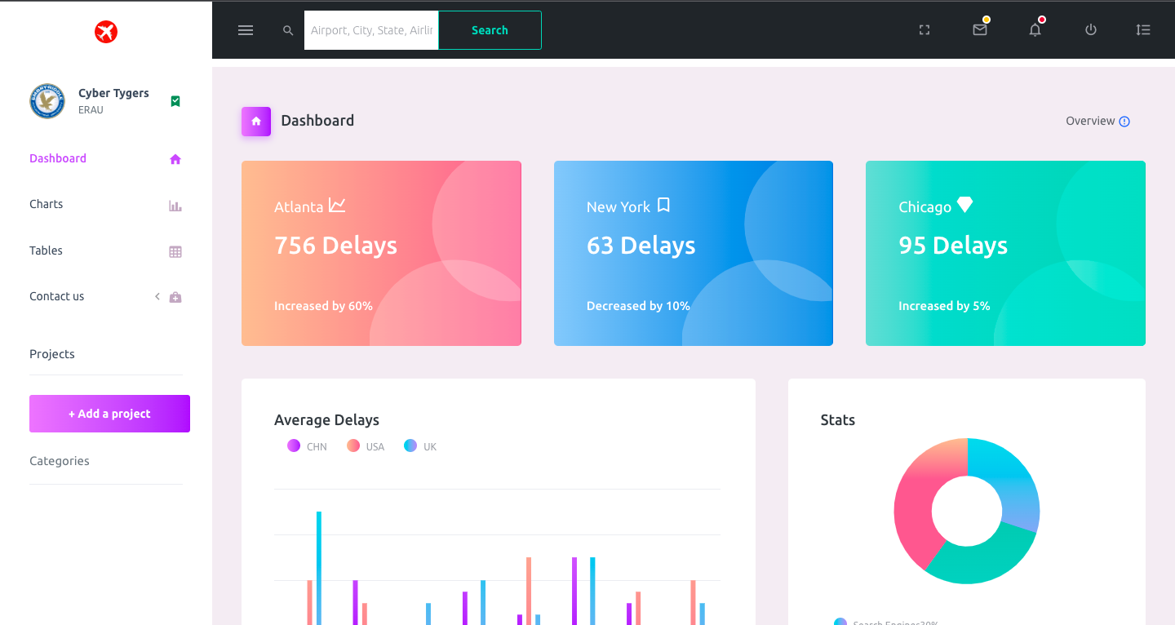
WEBSITE DEVELOPMENT - version 2
.

Slide 24
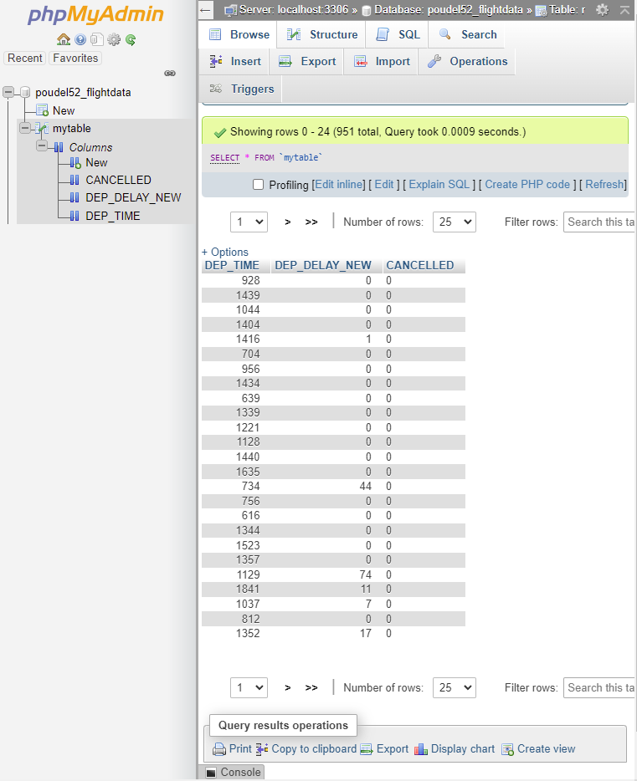
(phpMyAdmin was not used in favor of a local database solution)

Slide 25
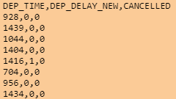
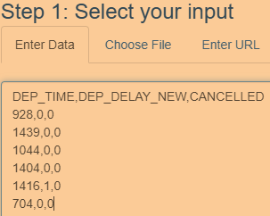
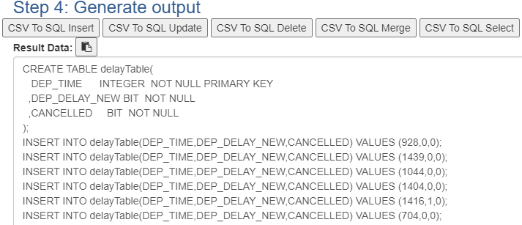
PHP Results
.
Data was added to server via PHPMyAdmin using SQL queries.
Convert CSV (comma separated values) to SQL via https://www.convertcsv.com/csv-to-sql.htm

Slide 26
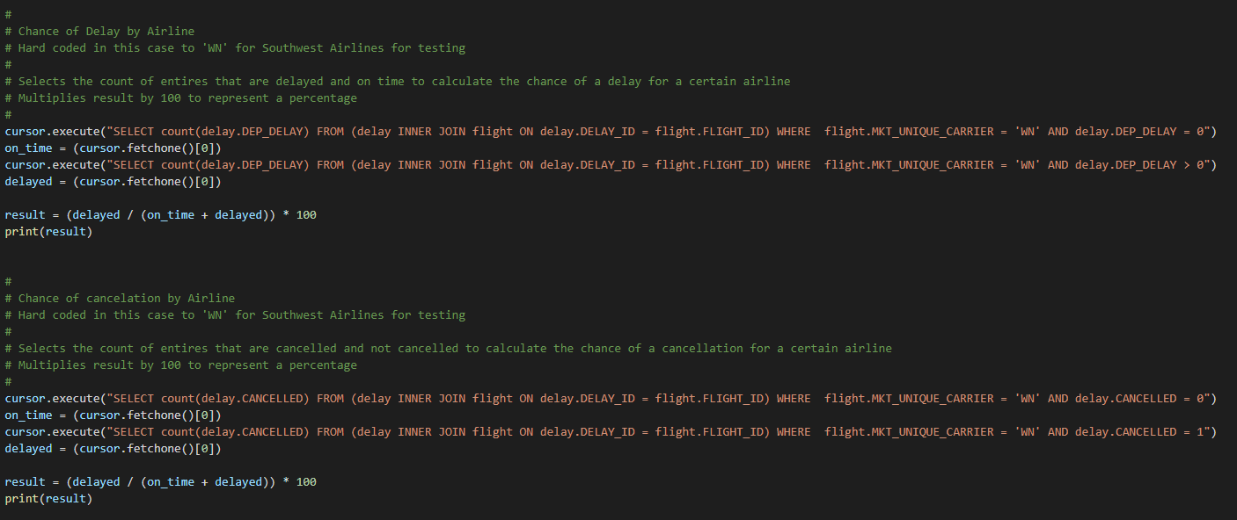
Code and Console Results
.

Slide 27
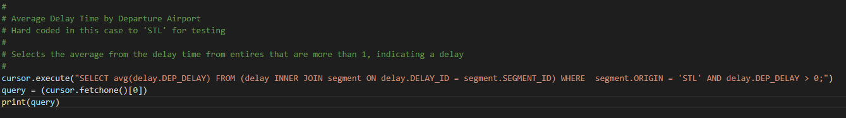
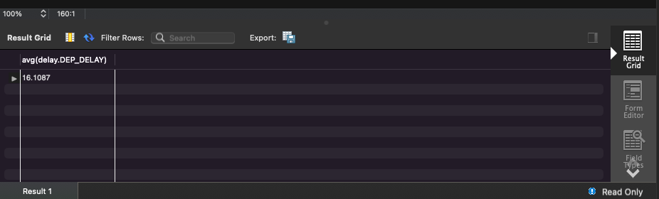
Code and Console Results
.

Slide 28
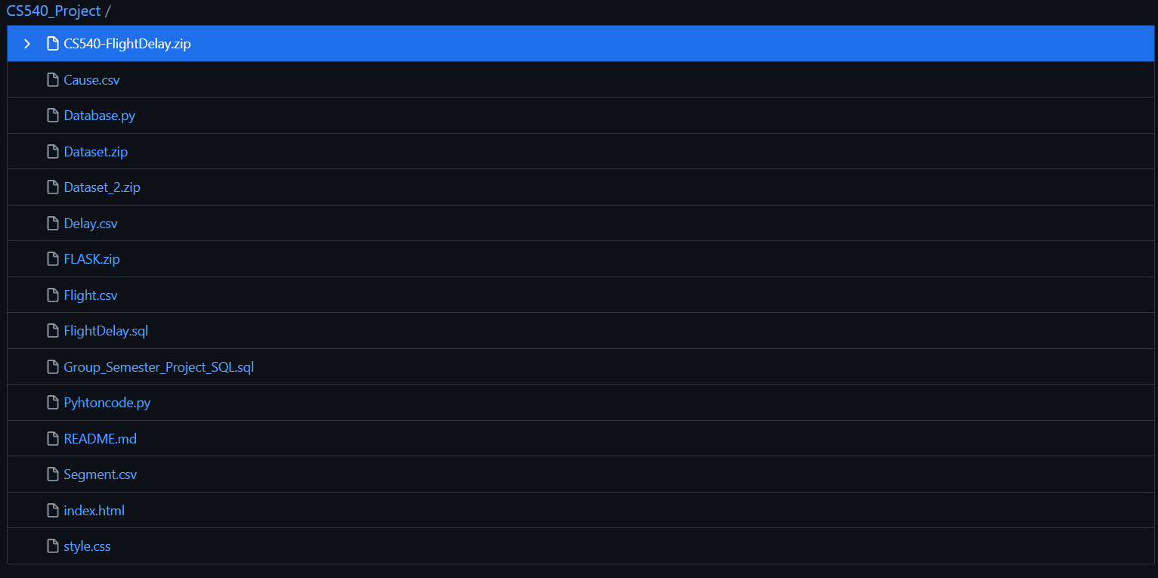
Current Files in Github
.

Slide 29
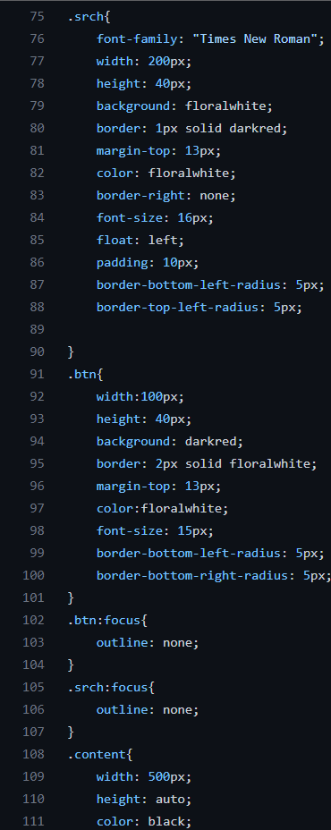
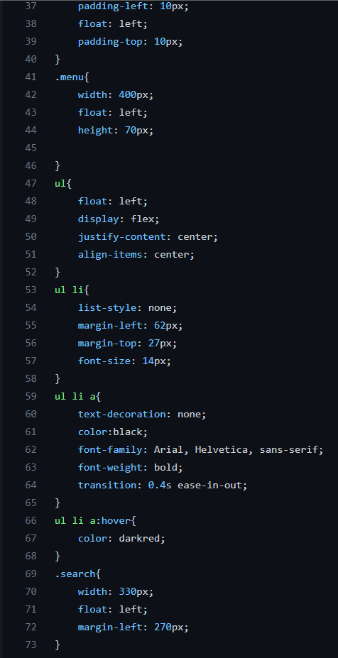
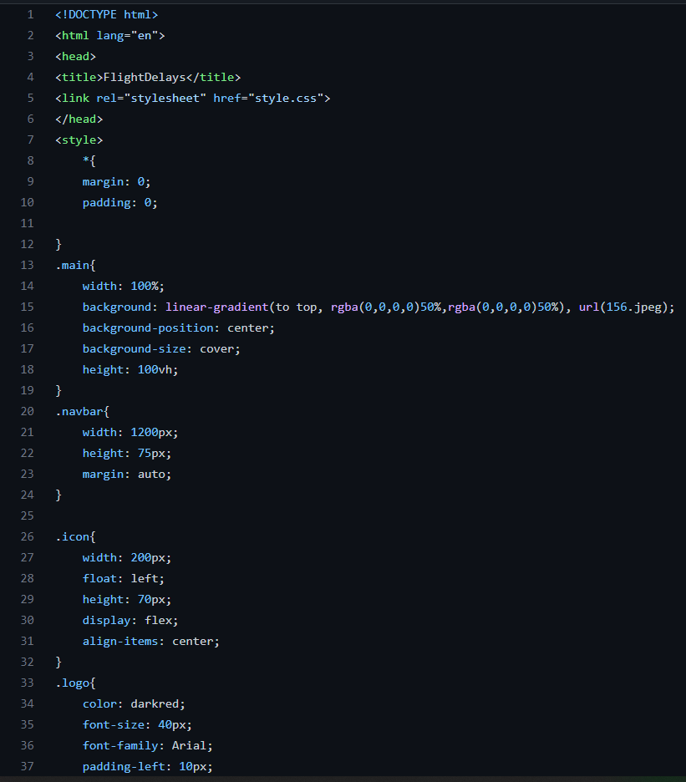
HTML/CSS

Slide 30
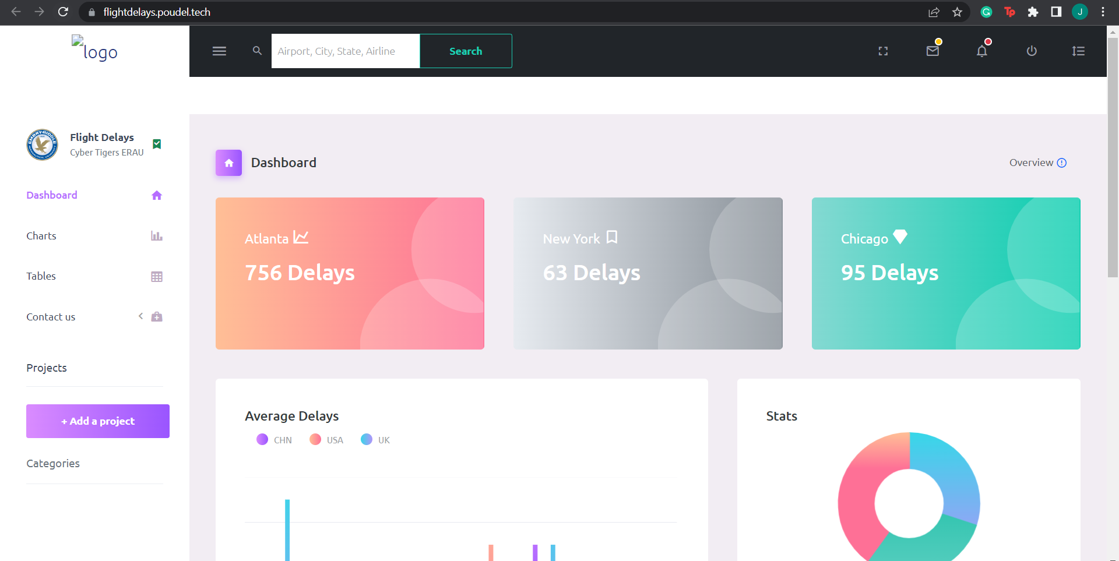
Website iteration 3

Slide 31
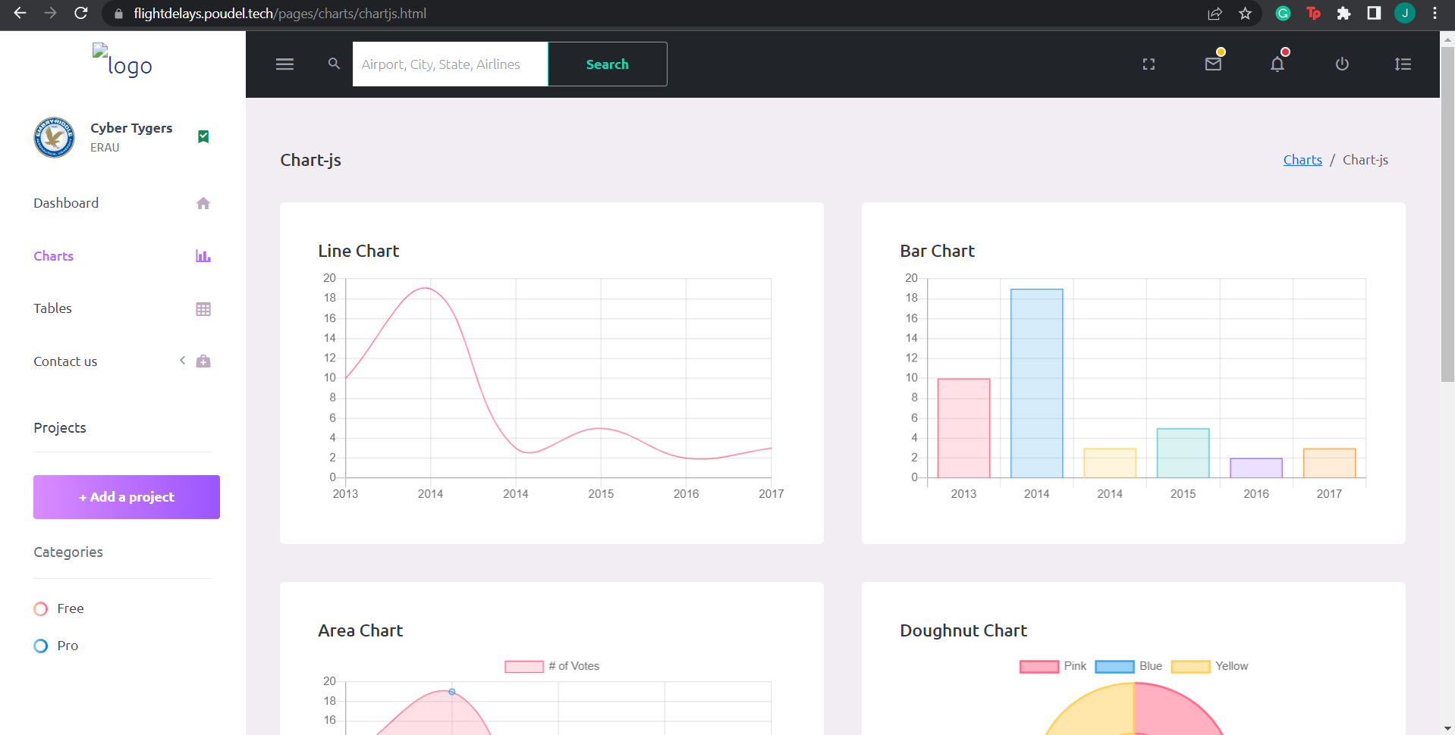
Website iteration 3

Slide 32
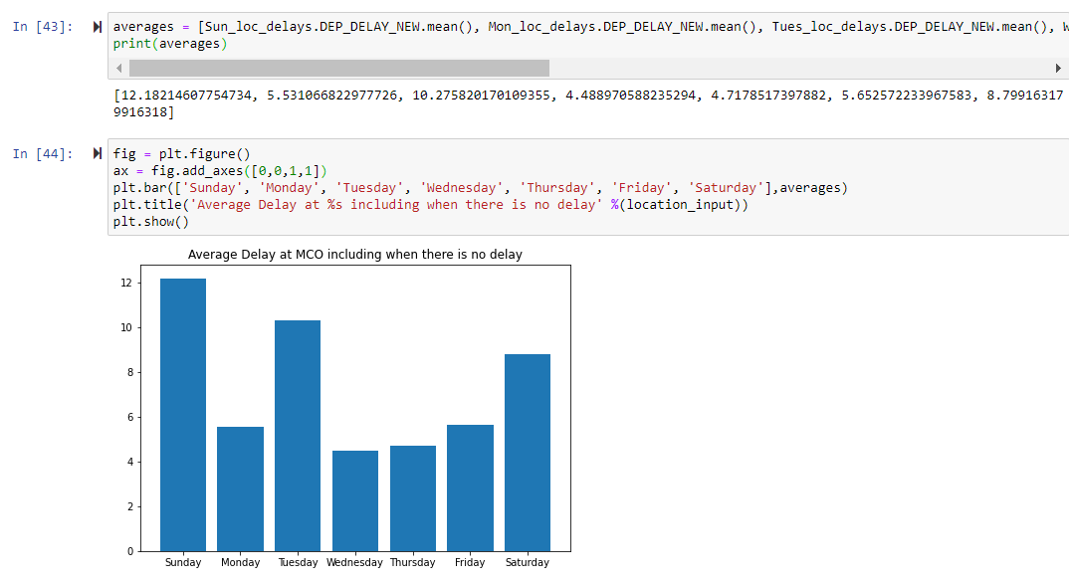
Python Graphing Practice

Slide 33
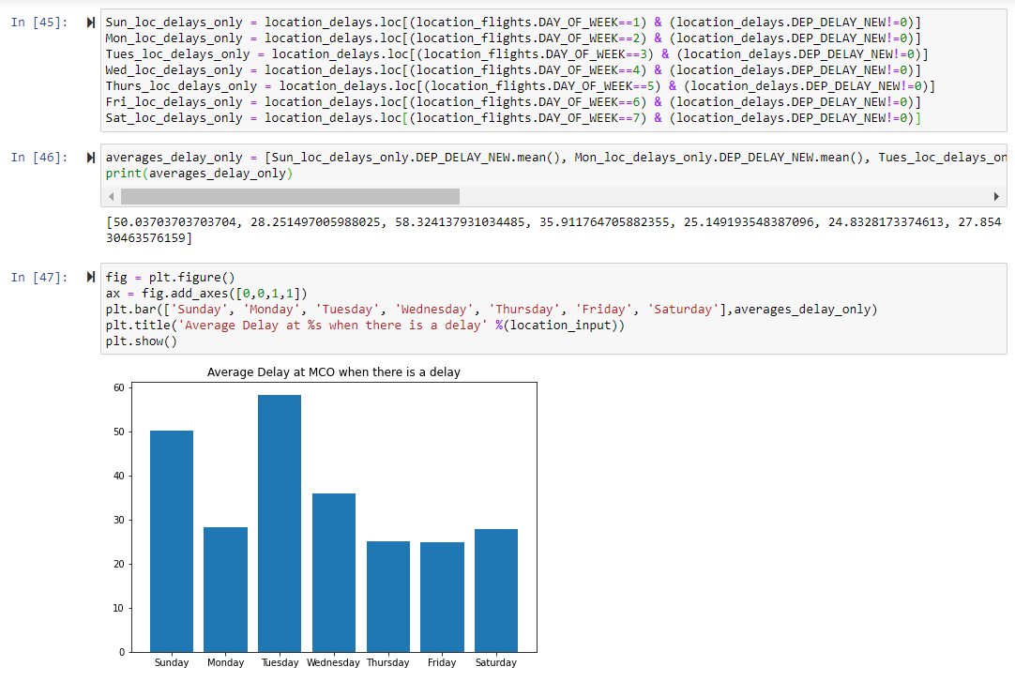
Python Graphing Practice

Slide 34
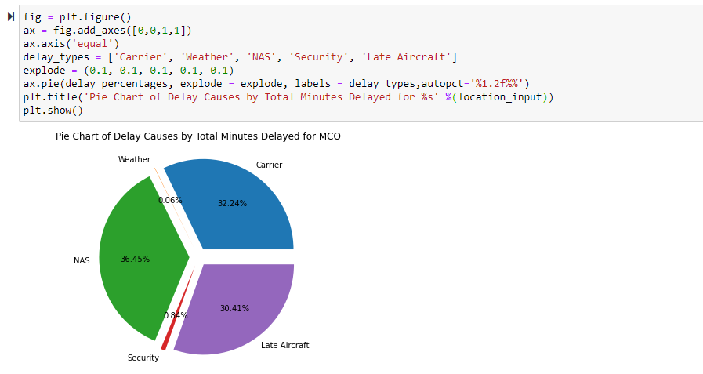
Python Graphing Practice

Slide 35
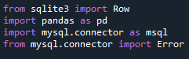
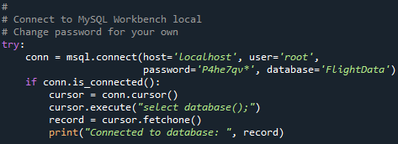
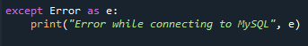
QUERYING THE RDBMS VIA PYTHON
IMPORTING THE LIBRARIES
CONNECTING THE DATABASE

Slide 36
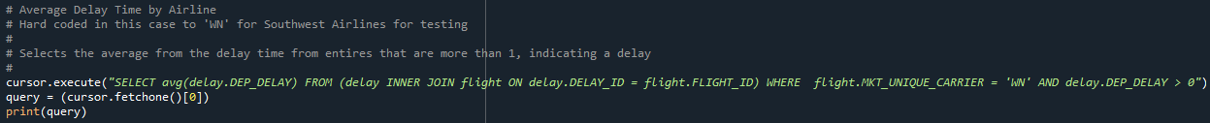
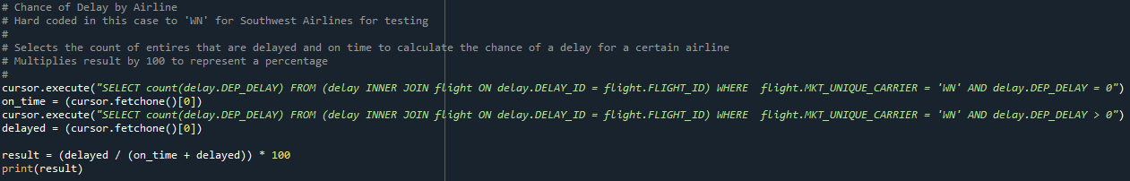
QUERYING THE RDBMS VIA PYTHON
FINDING AVERAGE DELAY FOR AN AIRLINE
FINDING TOTAL DELAY PERCENTAGE

Slide 37
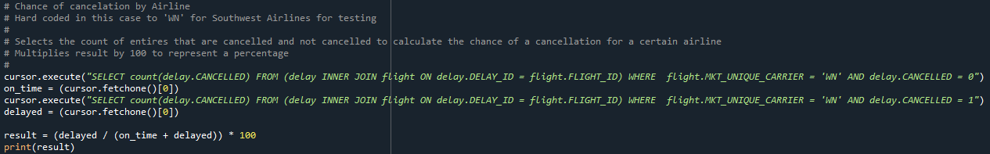
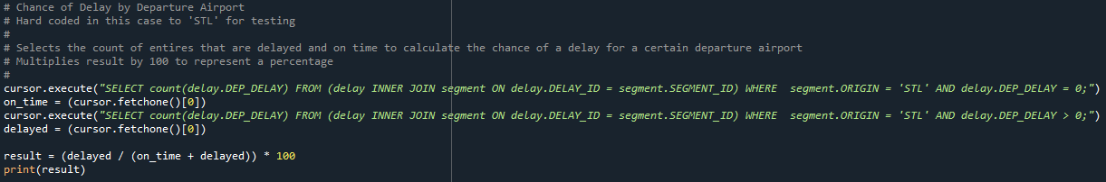
QUERYING THE RDBMS VIA PYTHON
FINDING TOTAL CANCELLATION PERCENTAGE FOR AN AIRLINE
FINDING TOTAL DELAY PERCENTAGE FOR AN AIRPORT

Slide 38
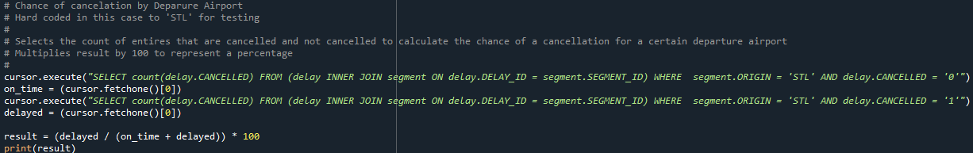
QUERYING THE RDBMS VIA PYTHON
FINDING TOTAL CANCELLATION PERCENTAGE FOR AN AIRPORT

Slide 39
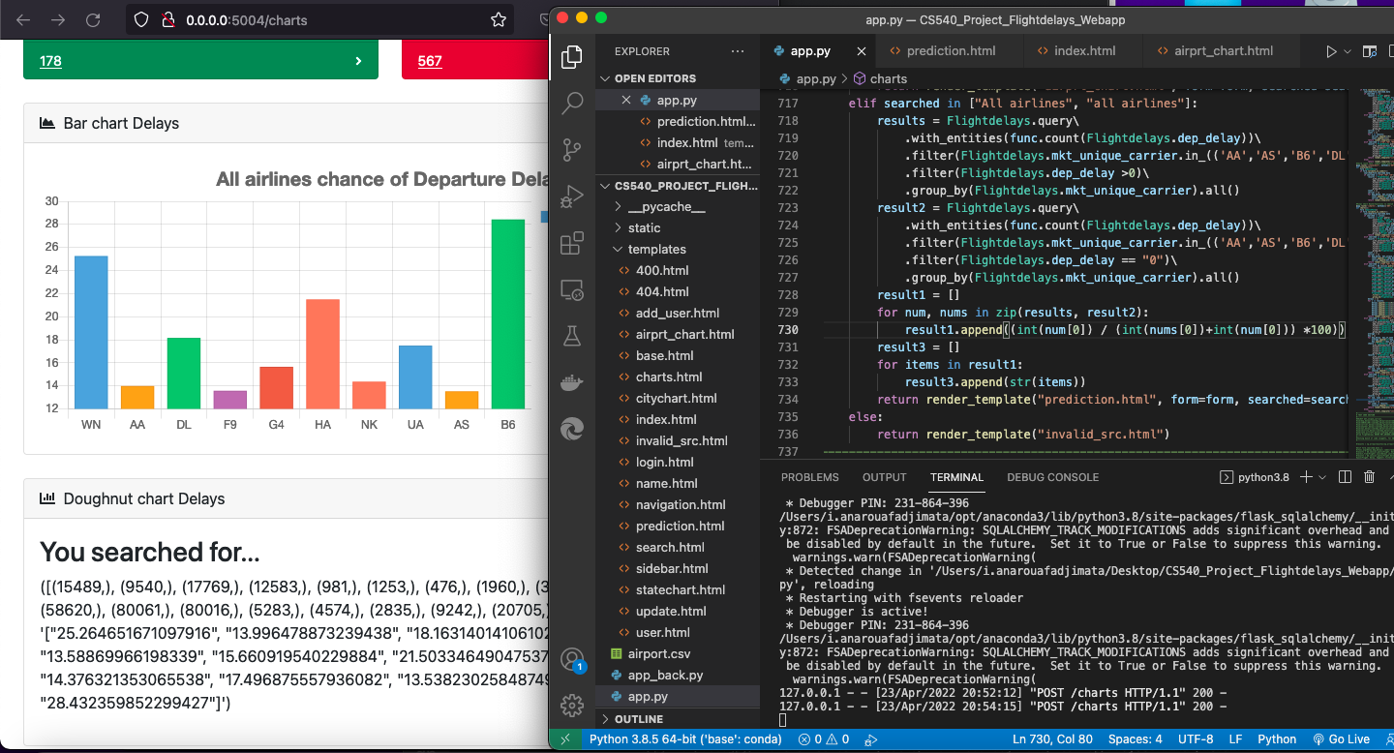
FINAL PRODUCT CODE SNIPPETS

Slide 40
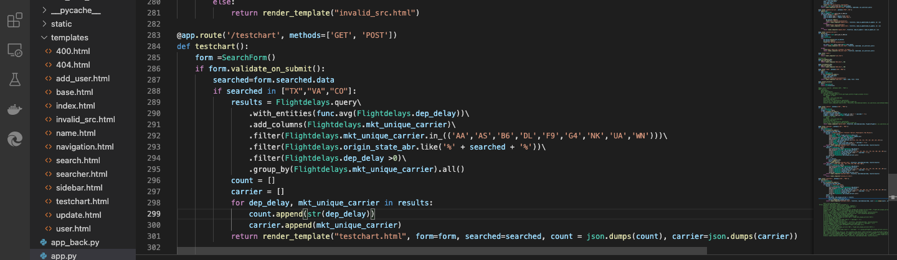
FINAL PRODUCT CODE SNIPPETS

Slide 41

FINAL PRODUCT CODE SNIPPETS

Slide 42

FINAL PRODUCT WEBSITE IMAGES (HOME PAGE)

Slide 43
CODE AND WEBSITE DEMONSTRATION

Slide 44
FUTURE WORK

Slide 45

Website hosting

Slide 46


Slide 47



Slide 48


Slide 49


Slide 50


Slide 51


Slide 52


Slide 53


Slide 54


Slide 55
MACHINE LEARNING
Logistics Regression
Need more data
Use attributes like time, delay, cancellations
Predict likelihood of delay
Other Regressions
Use same attributes as Logistics Regression but predict minutes of delay
Need more data
Instability of Air Travel Data
Air travel is affected by societal feeling of safety and economy
For example, the following events greatly impacted air travel
Events of 9/11
2008 Financial Crisis
COVID-19 Pandemic
Therefore, we did not go this route. We wanted to give the user the choice of how 2021 delays impact their flight choice of today.

Slide 56
GITHUB LINK
https://github.com/jmcsanders/CS540_Project

Slide 57
THANKS!
Any questions?
You can find us at
@erau & erau@mail.me

Slide 58
REFERENCES
[1] Bureau of Transportation Statistics (2021).Bureau of Transportation Statistics.
https://www.bts.gov/
[2] Bureau of Transportation Statistics (2021). On-Time : Marketing Carrier On-Time Performance (Beginning January 2018)
(51276413) [Data set]. Bureau of Transportation Statistics. https://www.transtats.bts.gov/DLSelectFields.asp?gnoyrVQ =F GKQOfu146anzr = b0−gvzr
[3] Bureau of Transportation Statistics. (2022, January 10). Understanding the Reporting of Causes of Flight Delays and Cancellations. Bureau of Transportation Statistics. https://www.bts.gov/topics/airlines-and-airports/understanding-reporting-causes-flight-delays-and-cancellations
[4] Yazdi, M. F., Kamel, S. R., Chabok, S. J. M., & Kheirabadi, M. (2020). Flight delay prediction based on deep learning and Levenberg-Marquart algorithm. Journal of Big Data, 7(1). https://journalofbigdata.springeropen.com/articles/10.1186/s40537-020-00380-z

